Slide 1
Public Engagement with Chinese Characteristics?
State-Science-Society Dynamic in Mainland China
Dr Joy Y. Zhang
y.zhang-203@kent.ac.uk
University of Kent

Slide 2
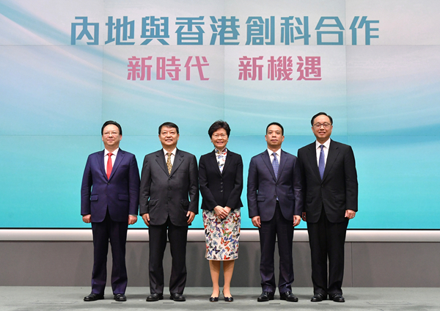


Slide 3

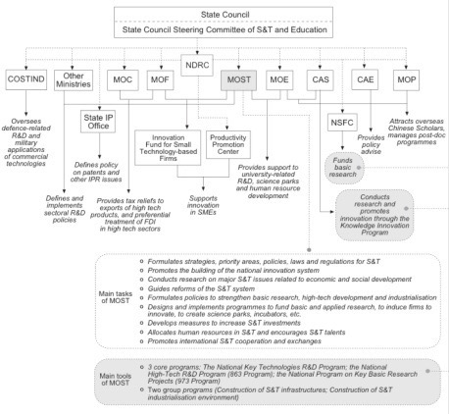
Public/ Public Engagement?

Slide 4
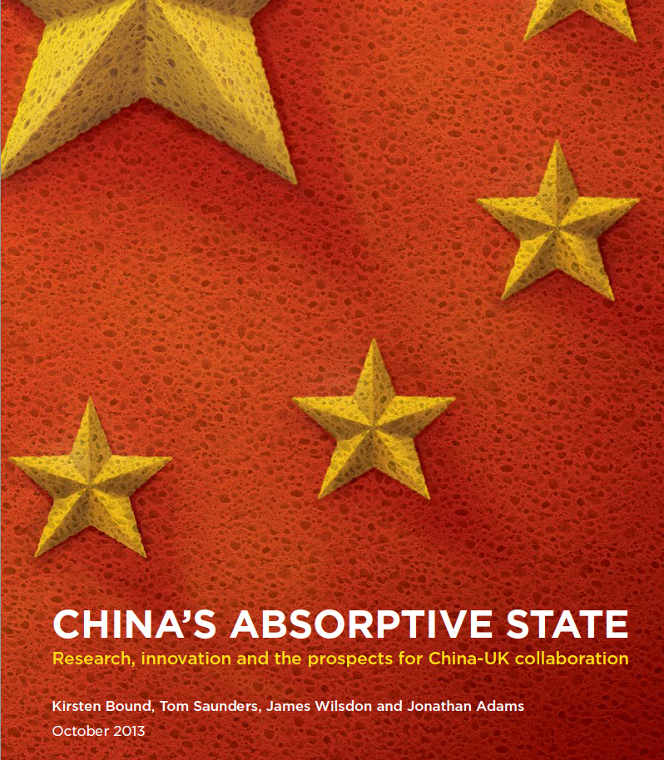

Public/ Public Engagement?
‘Legislative boom’

Slide 5
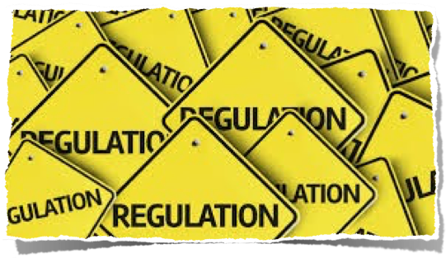


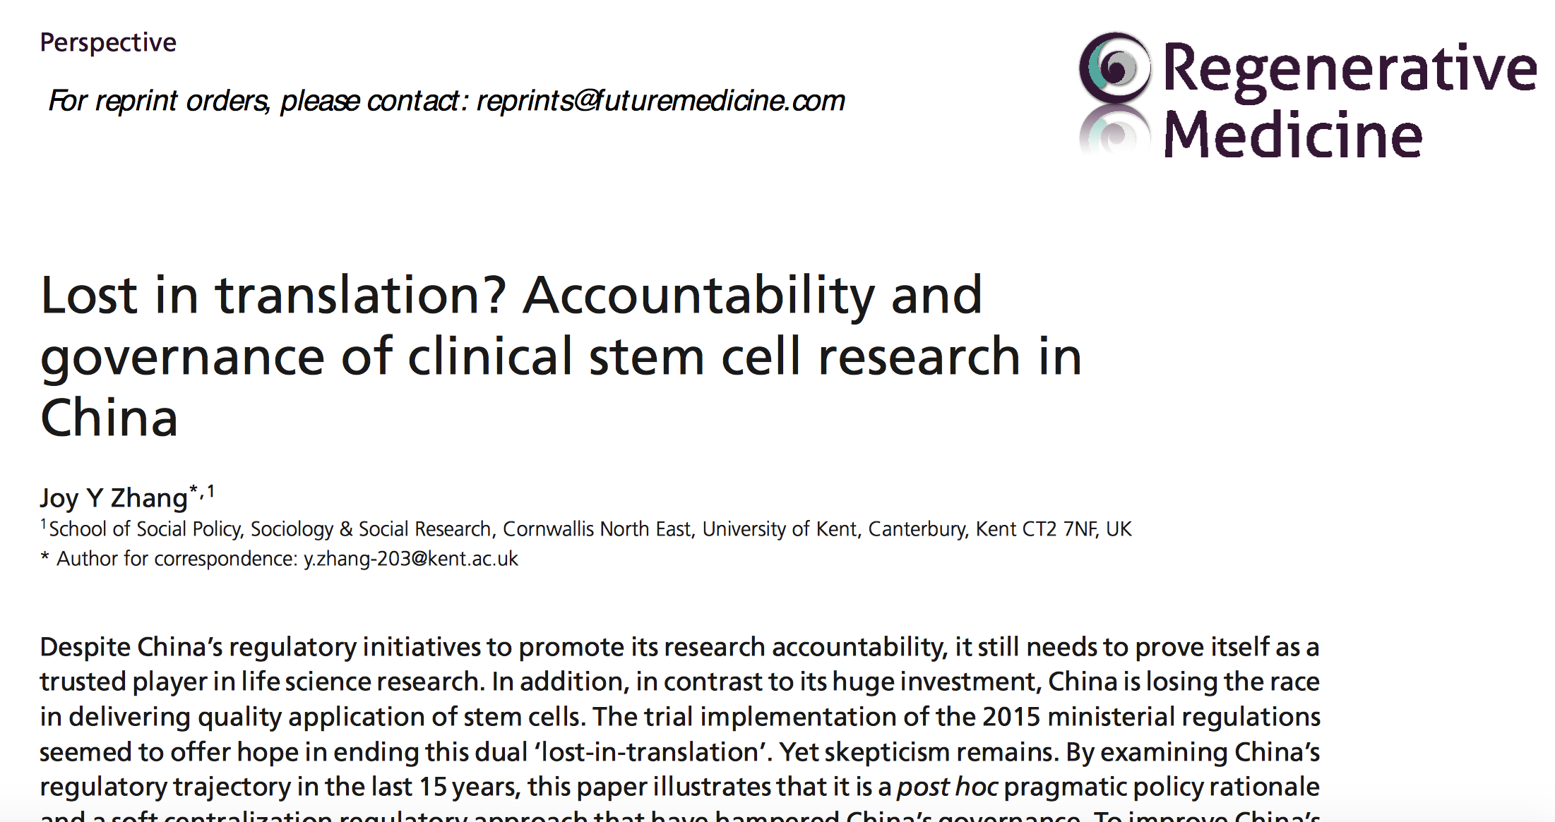
Post-hoc Pragmatism
‘…Leading Chinese bioethicist Wang Yanguang described a common view among Chinese regulators in the health sector as dismissive for the incorporation of social debates into policy making for “however laudable the goals”, such practice will appear to be inefficient….’

Slide 6
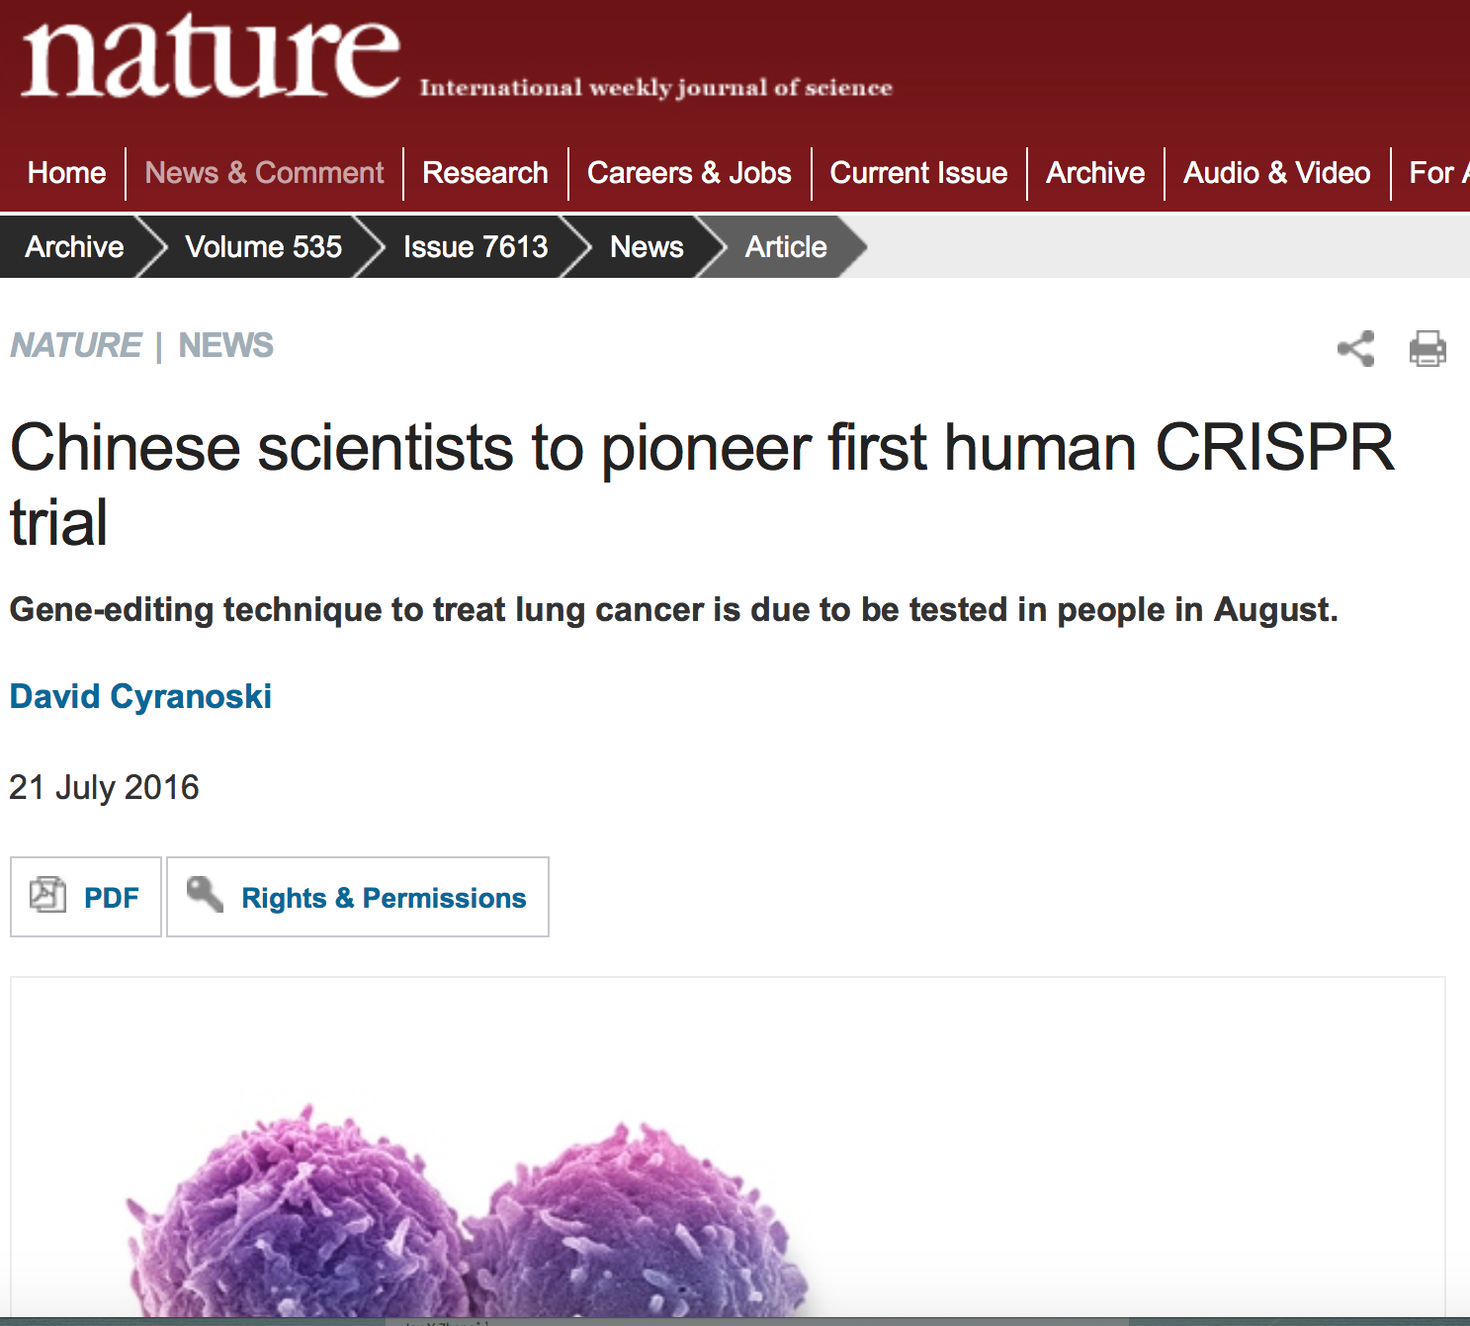
Lu says that the review process, which took half a year, required that the team invest a lot of time and human resources, including close communication with the hospital’s internal review board (IRB). “There was a lot of back and forth,” he says.
The NIH’s approval of the other CRISPR trial “strengthened ours and our IRB’s confidence in this study”, he adds.

Slide 8
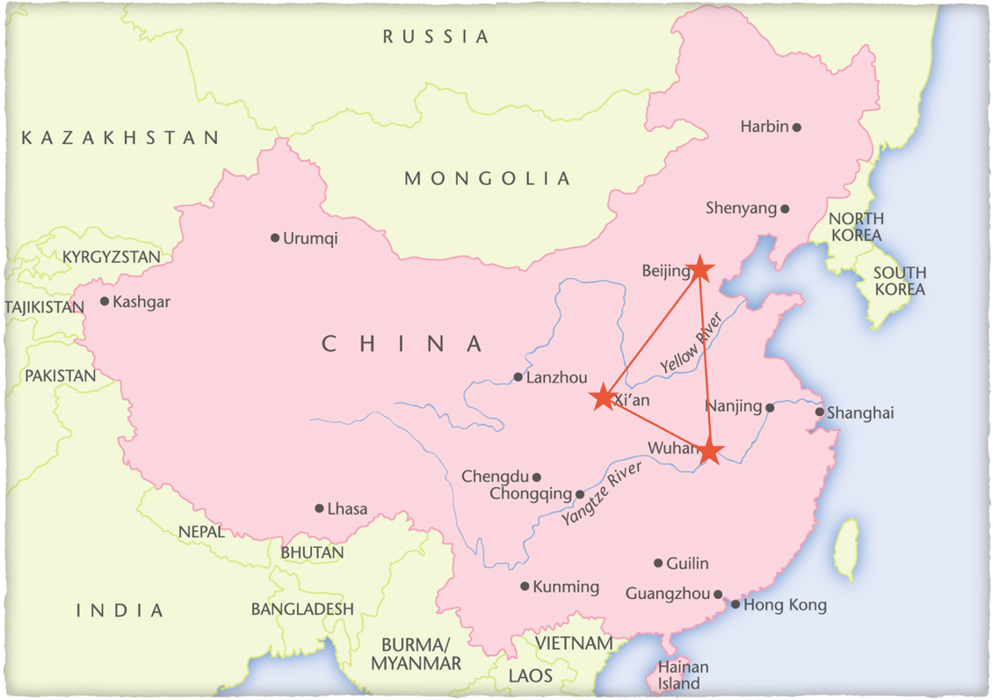

Slide 9
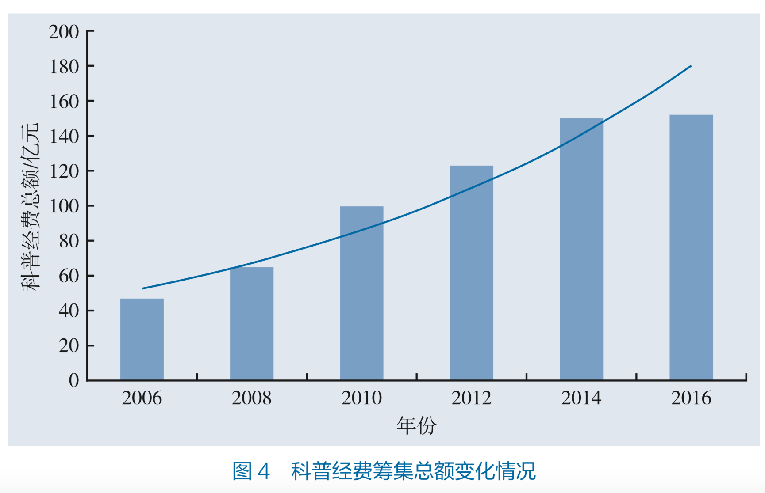
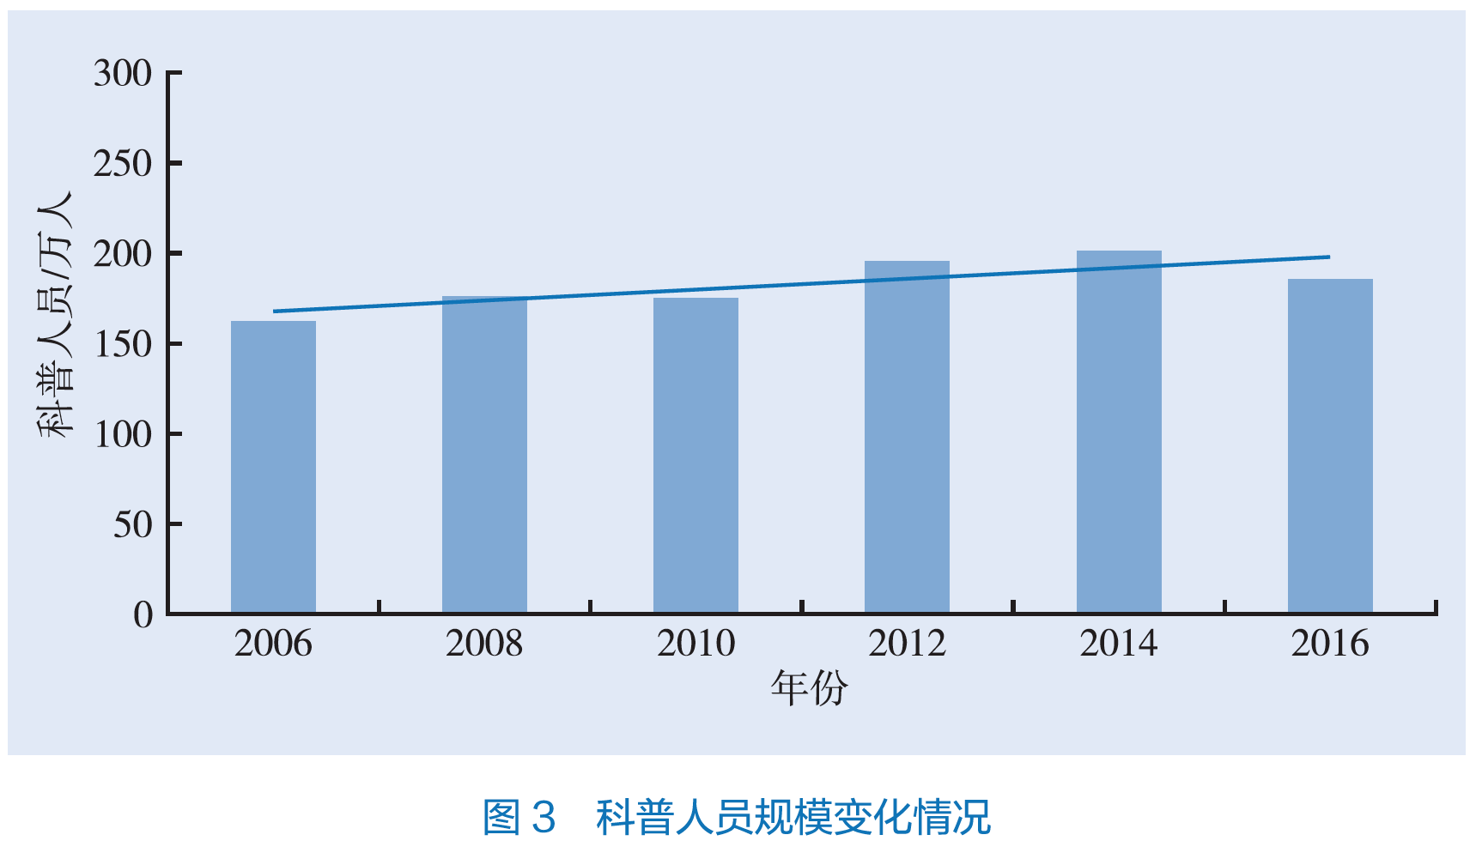
Increased funding
on science popularisation
since 2006
Expansion of science communication
professionals since 2006

Slide 10
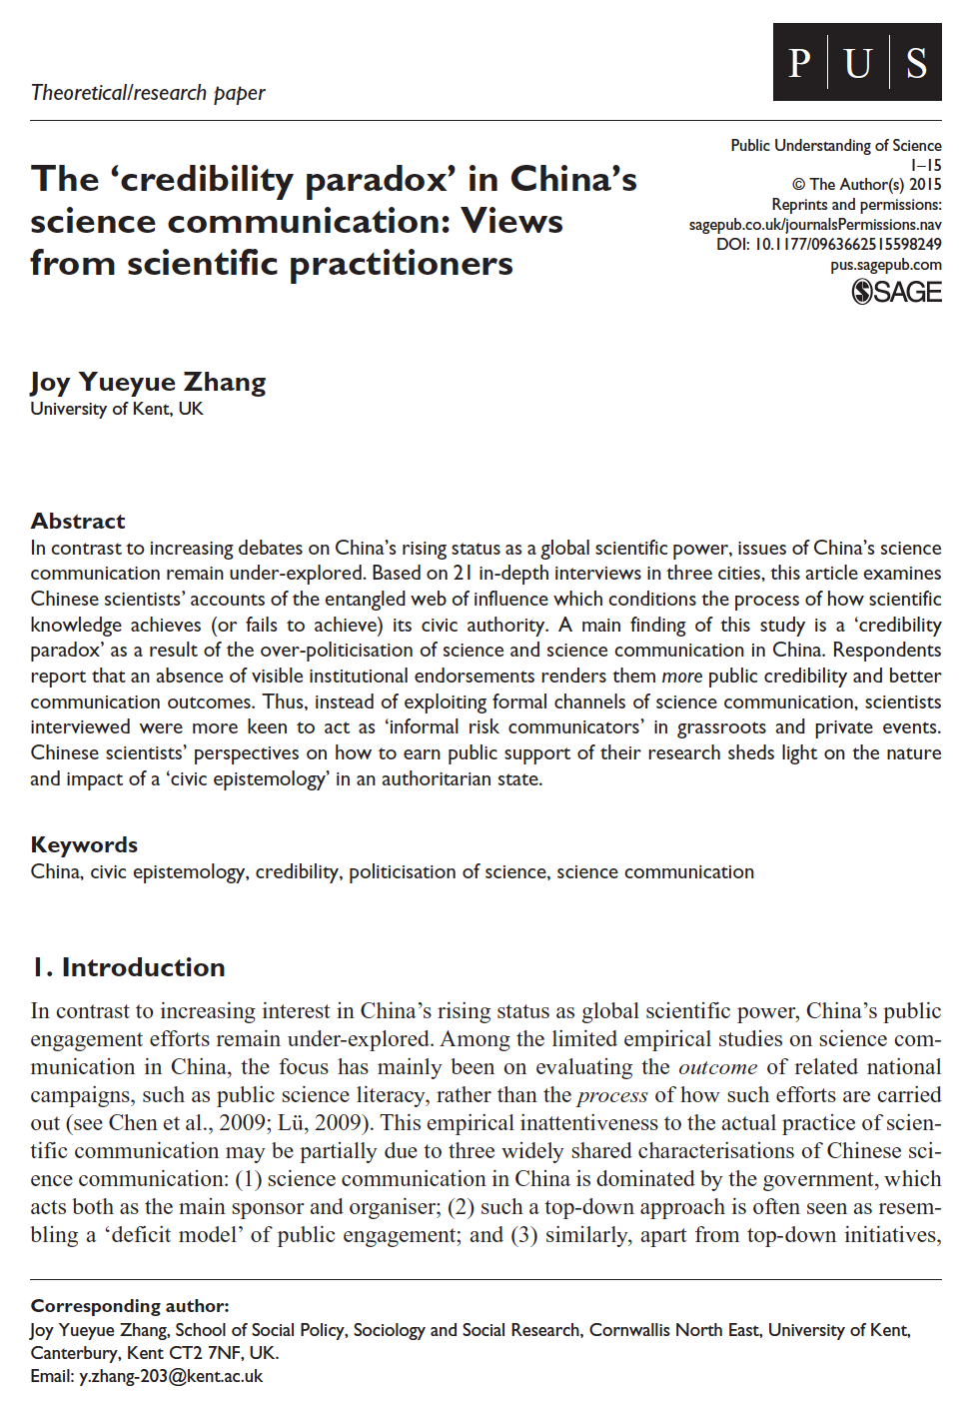
Credibility Paradox
The public perception of scientists’ credibility was often inversely proportional to the level of institutional backing.
“Am I ‘qualified’ to talk about my work?”

Slide 11
Does the public know what they want?

Slide 12
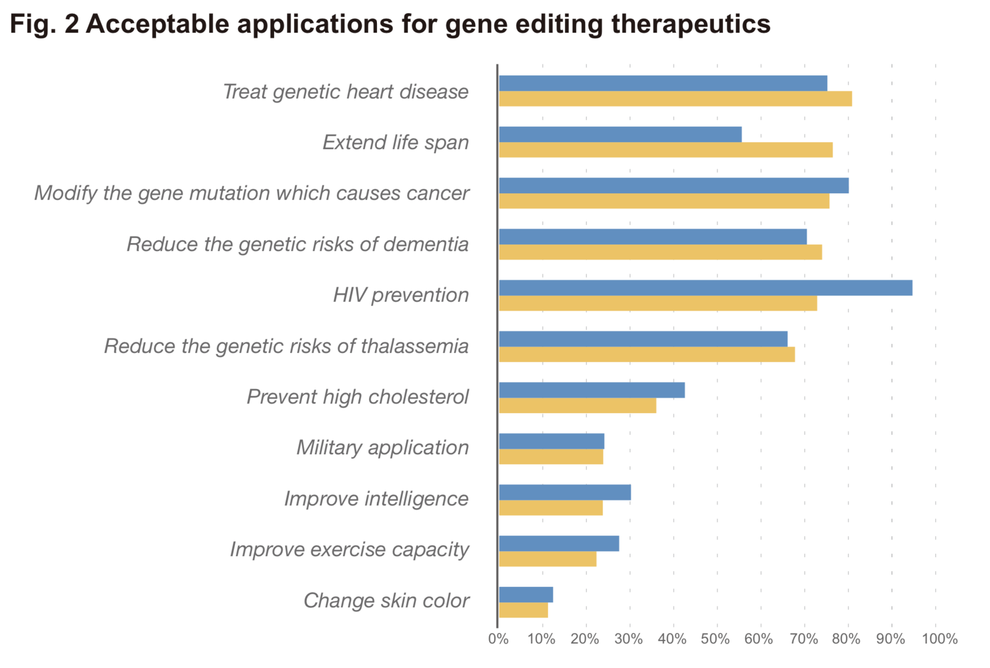


Slide 13


What is the role of scientific evidence in the public realm in China?
Possibility
Choice

Slide 14
What is the role of scientific evidence in the public realm?
Possibility
Choice

Slide 15
What is the role of scientific evidence in the public realm?
Culture vs. Technology
Cultures of Technology

Slide 16

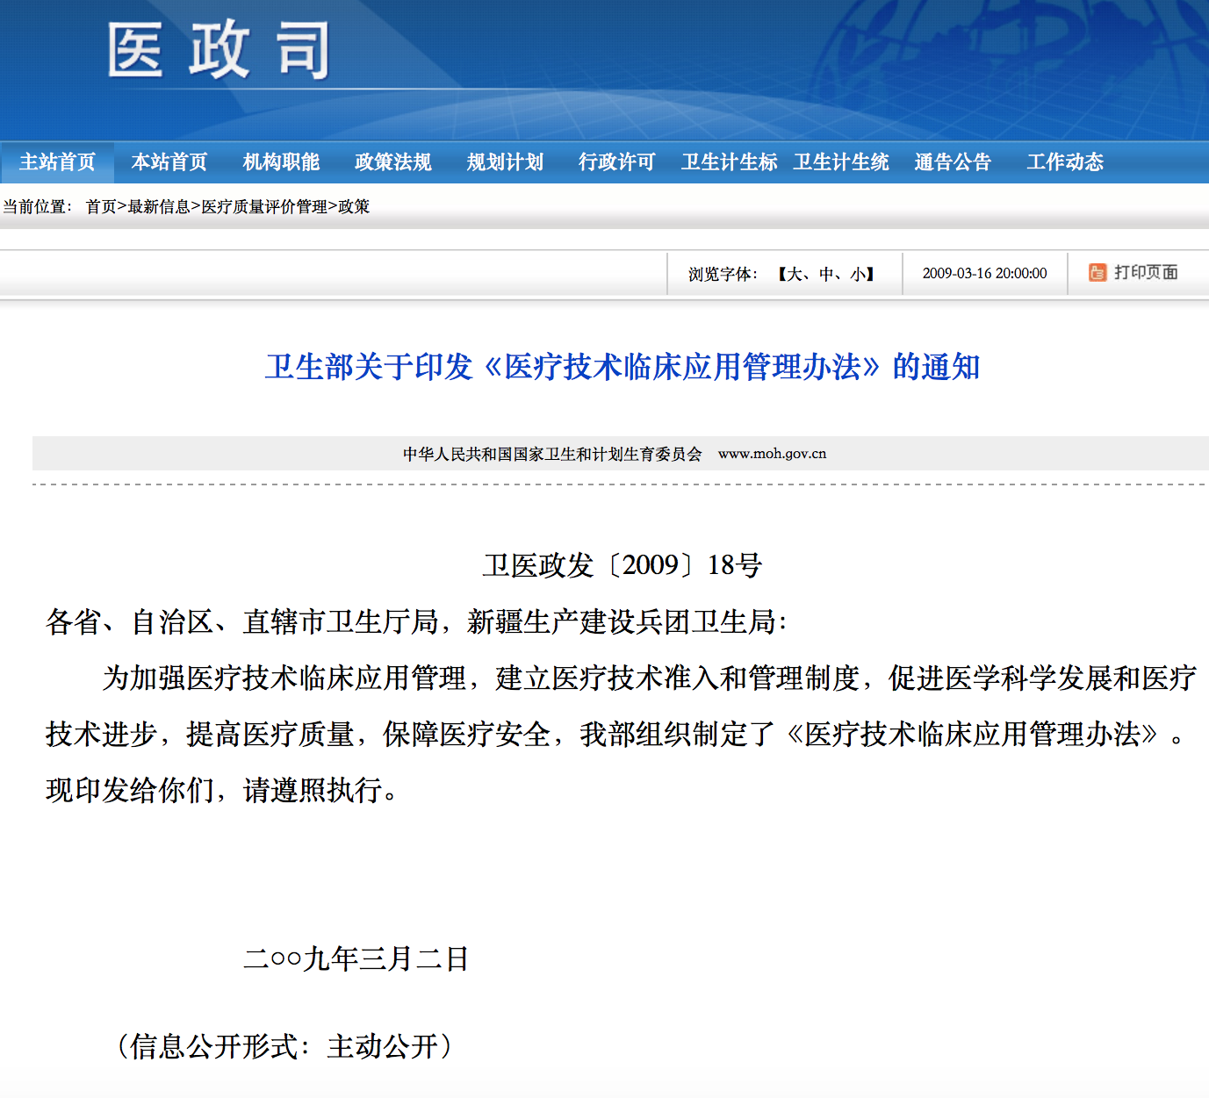
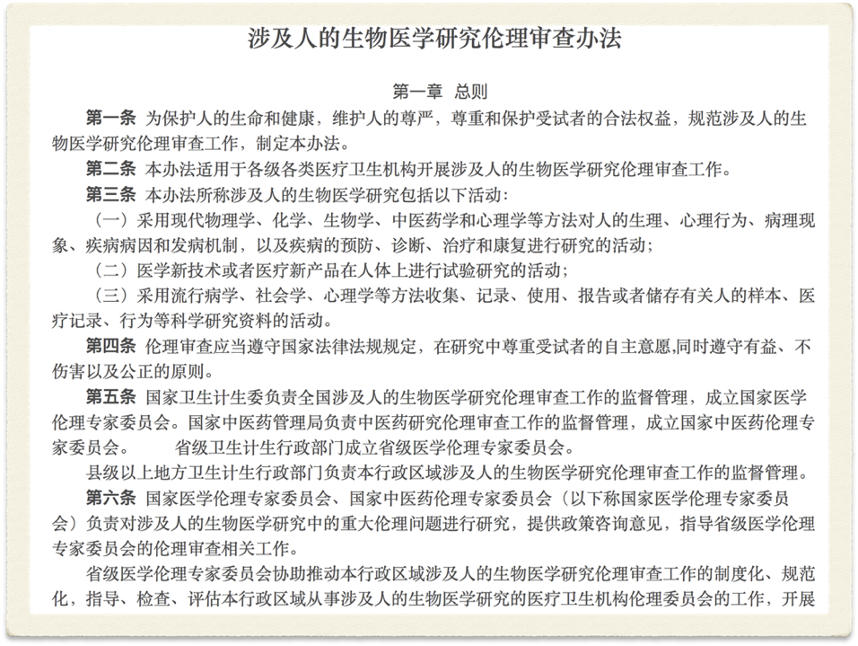
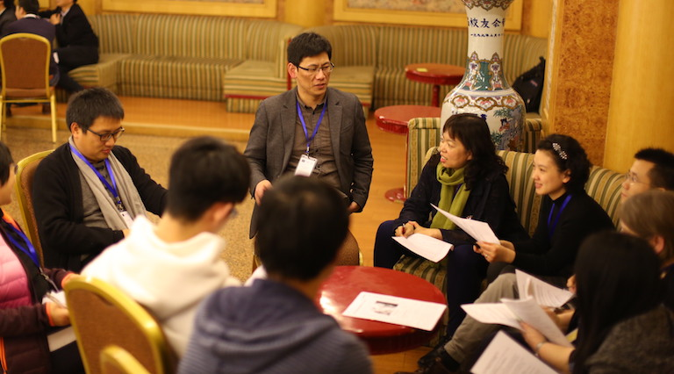
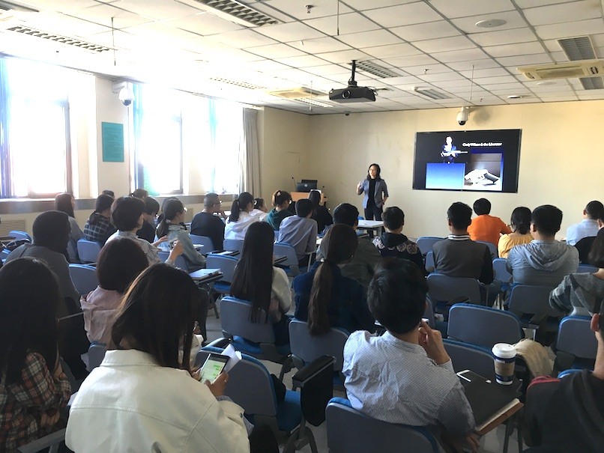
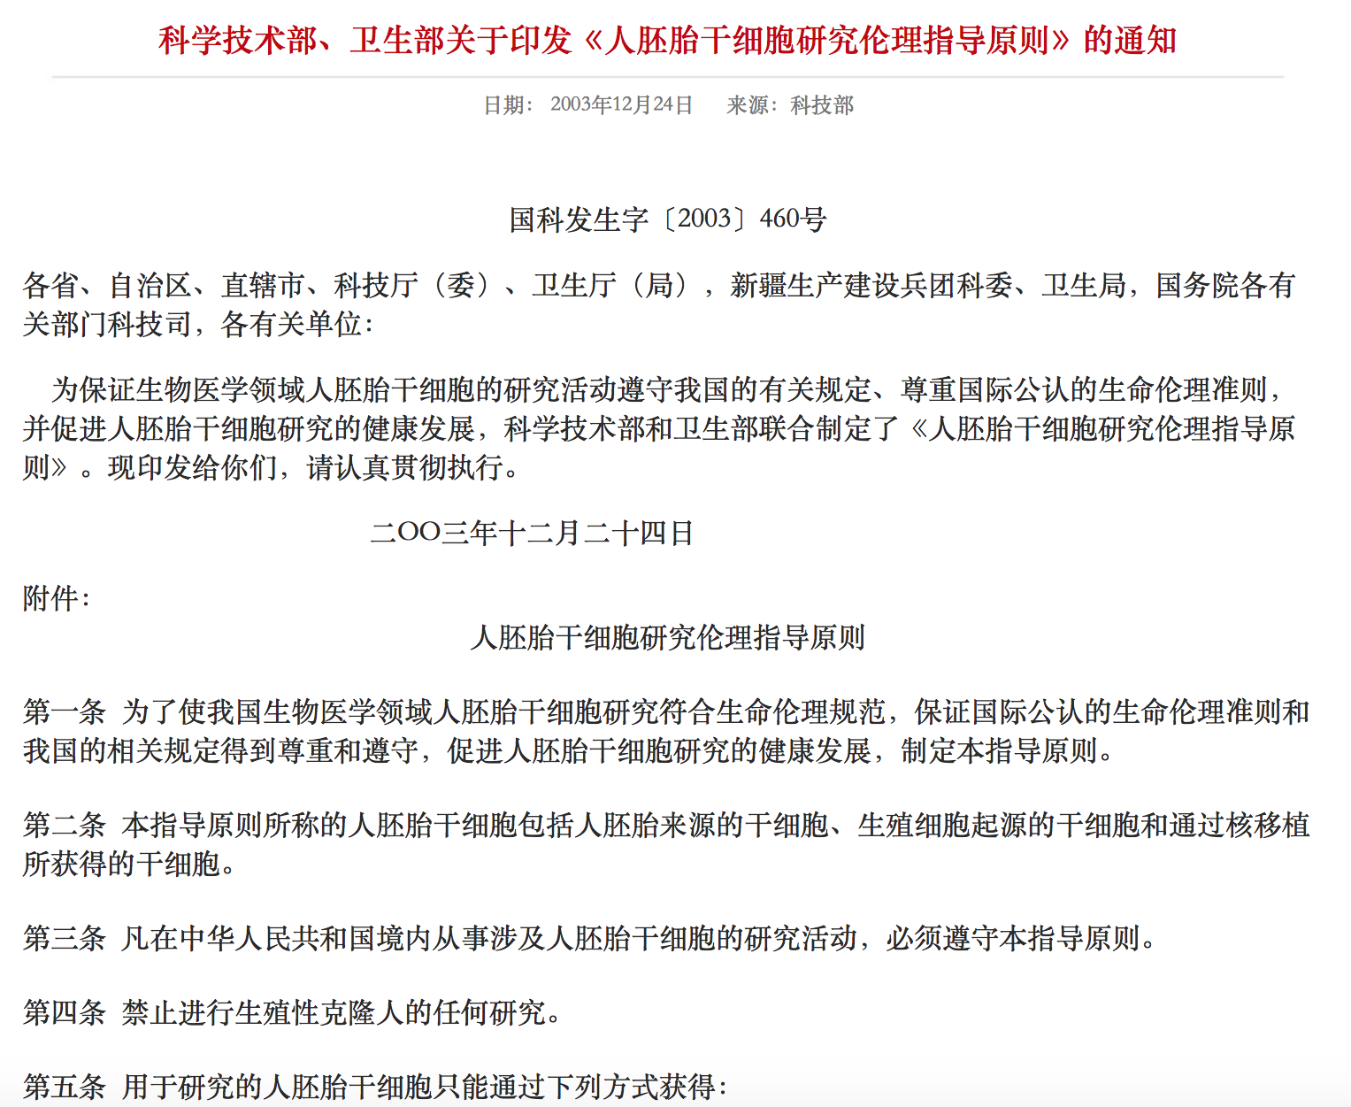

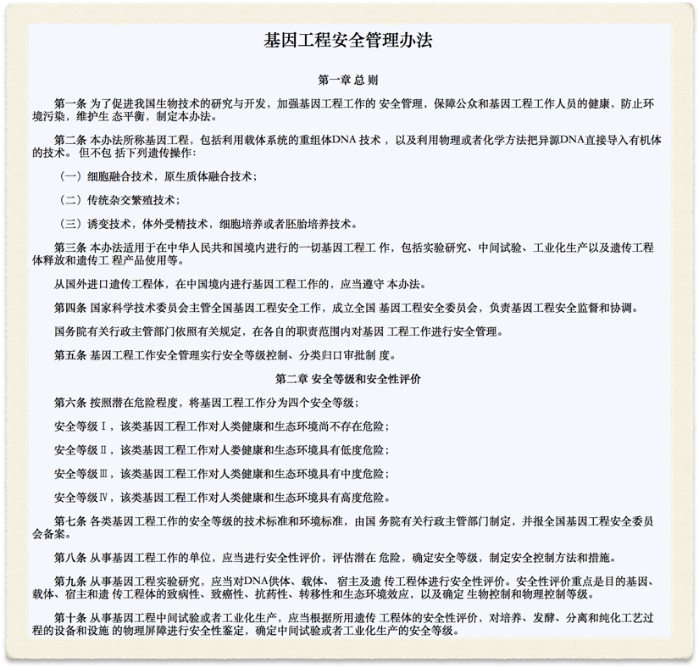
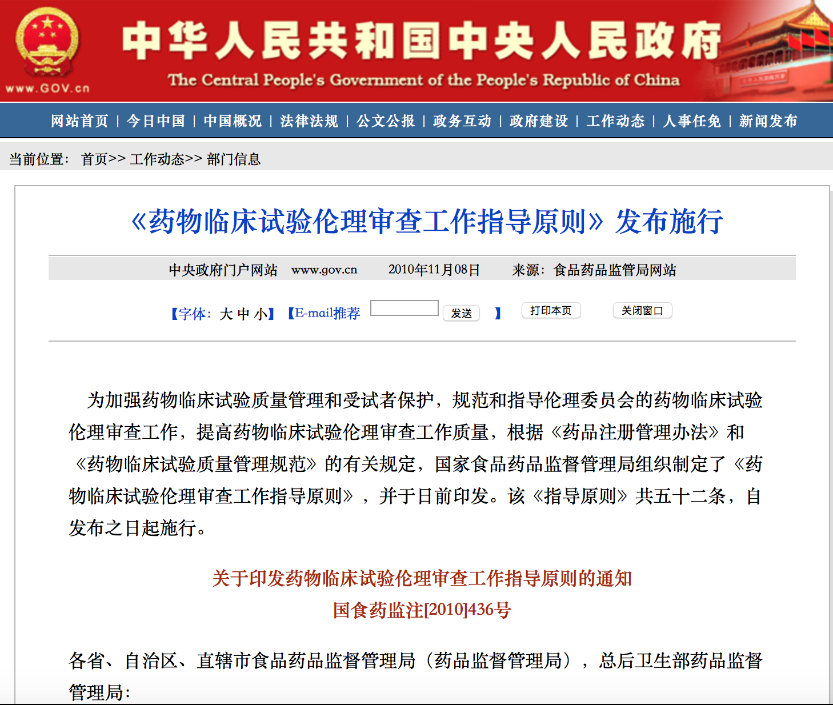

Slide 17
Public Engagement with Chinese Characteristics?

Slide 18
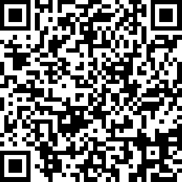
Please let us know your view —
it will take only 3 mins!

